Slide 1

A.I.DA
Federico
Stella
Photo by Daniel Spase on Unsplash

Slide 2
A.I.DA
Federico
Stella
Java-based evolutionary generation of monophonic melodies with limited domain knowledge, customizable scales and fitness assigned by a human
Photo by Daniel Spase on Unsplash

Slide 3

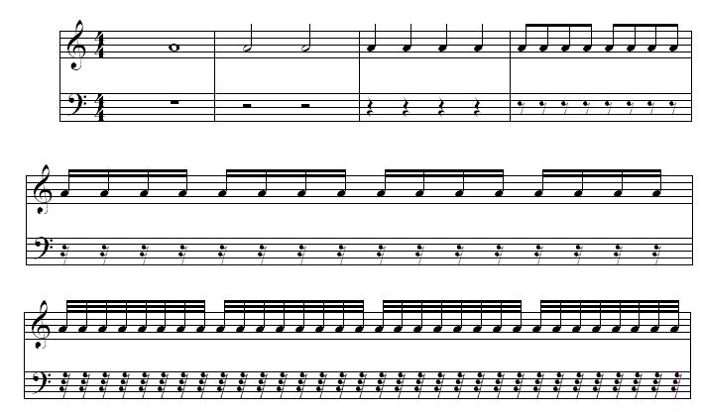
What’s music?
Measures
Semibreve
Minim
Quarter
Eighth
Rests

Slide 4
Digital music: simplified MIDI
Channel0
Message (i.e. Note ON,
Note OFF, etc.; channel)
Track0
Track1
…
Sequence
MidiEvent
…
Channeln
Trackn
List<MidiEvent>
Tick (time instant of event onset)
sequence = new Sequence(Sequence.PPQ, 2);
sequencer.setTempoInBPM(120);
Beats per minute
Pulses per beat (quarter)
2 pulses for each quarter note
=> max resolution = eighth note

Slide 5
Genotype
MidiEvents are unnecessarily cumbersome, and notes keep playing unless a NoteOff event is sent for that specific note.
=> Simplifying the interface with ad-hoc TickEvents
Chromosome
TickEvent | TickEvent | TickEvent | TickEvent | TickEvent | TickEvent | TickEvent | TickEvent
NoteOffevent -> Stops the previous note
<<interface>>
TickEvent
NoteOnEvent -> Stops the previous note and starts playing a new one
Contains a number that will be mapped to a note
HoldEvent -> Holds the last event (longer pause or longer note)

Slide 6
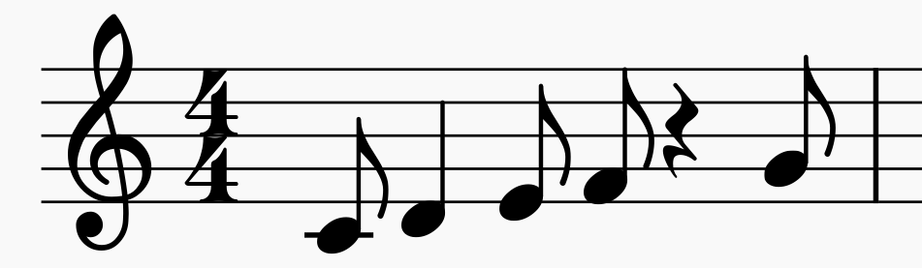

Phenotype mapping
Chromosome
Note_0 | Note_1 | Hold | Note_2 | Note_3 | OFF | Hold | Note_4
Scale (example: C Major)
C4 | D4 | Hold | E4 | F4 | OFF | Hold | G4
Eighth
Quarter
Eighth
Eighth
Quarter rest
Eighth

Slide 7
Genetic algorithm
tournamentSize = 4
mutationProbability = 0.2
noteRange = 6 to 10
public List<Measure> produceNewIndividuals(List<Measure> population, int num) {
List<Measure> result = new ArrayList<>();
for (int i=0; i<num; i++) {
List<Measure> candidates = RandomGenerator.getGenerator()
.randomFromPopulation(population, tournamentSize); //Uniformly random
Measure parent1 = new Tournament(candidates).getWinner(); //Highest fitness
candidates = RandomGenerator.getGenerator()
.randomFromPopulation(population, tournamentSize);
Measure parent2 = new Tournament(candidates).getWinner();
Measure child = SimpleCrossOver.getInstance().apply(parent1, parent2);
Measure childMutated = SimpleMutation.getInstance()
.mutate(child, mutationProbability, noteRange);
result.add(childMutated);
}
return result;
}

Slide 8
Crossover
Mutation
Random selection of the split point
Generation of a single child
Parents aren’t kept
Block-based
Probability of replacement of each TickEvent
Note_0 | Note_3 | Hold | Note_1
Parent 1
Note_0 | Note_3 | Hold | Note_1
OFF | Note_6 | Note_4 | Note_4
Parent 2
OFF | Note_1 | Note_2 | OFF
Note_0 | Hold | Hold | Note_7
Note_0 | Hold | Hold | Note_7
Child

Slide 9
Crossover
Mutation
Random selection of the split point
Generation of a single child
Parents aren’t kept
Block-based
Probability of replacement of each TickEvent
Parent 1
Note_0 | Note_3 | Hold | Note_1
OFF | Note_6 | Note_4 | Note_4
Parent 2
OFF | Note_1 | Note_2 | OFF
Note_0 | Hold | Hold | Note_7
Child
Note_0 | Note_5 | Hold | Note_1
Note_0 | Note_2 | Hold | Note_7

Slide 10

Practical limitations
With noteRange = 8 and measureLength = 16, the state space contains:
geneOptions = noteRange + OFF + HOLD = 10
numGenes = measureLength = 16
State space dimension $≅{16}^{10}=2^{4^{10}}=2^{40}≅1 trillion$
Fitness is assigned by the user
Playing a measure requires $16 ∗\frac{60 seconds}{120 PPM ∗ 2 PPQ}=4 seconds$
Population size is limited by the human factor, limiting the diversity of the produced music
In order to avoid a quick convergence to very bad local maxima, a certain amount of measures is randomly generated from scratch in each new generation, refreshing the population

Slide 11
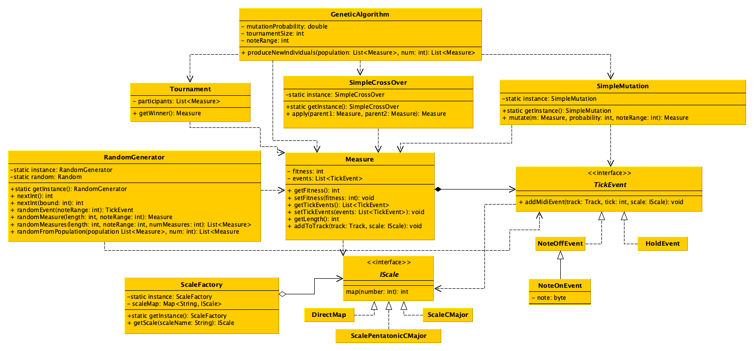
UML

Slide 12
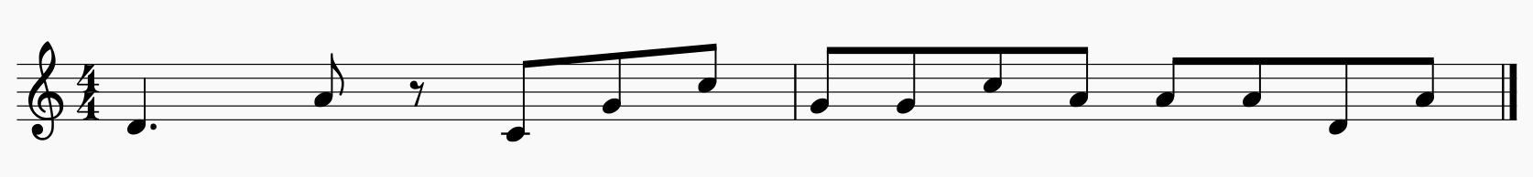
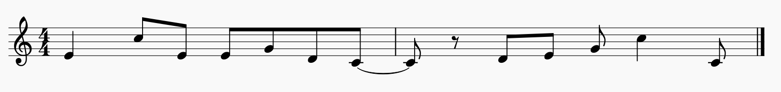
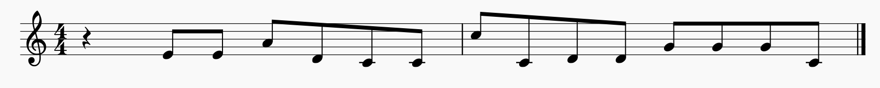
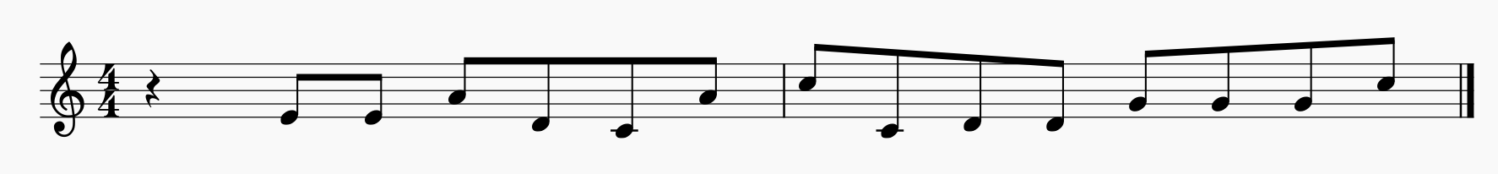
Results (Pentatonic C Major)
Gen 1
Random
Learned low-pitched conclusion
Gen 5
Better note sequences
Gen 7
Learned high-pitched conclusion
Gen 8

Slide 13
References
Biles, John. (1994). GenJam: A Genetic Algorithm for Generating Jazz Solos.
Biles, John. (2013). Straight-Ahead Jazz with GenJam: A Quick Demonstration.
Thank you!

